Slide 1
RESEARCH & NUMERICAL INVESTIGATION
Wind-Induced Aerodynamic Forces on Isolated and Arrayed Solar Panels
Computational Fluid Dynamics (OpenFOAM k-ω SST) Evaluation of Extreme Storm Loading, Parametric Tilt & Yaw Sweeps, Multi-Row Sheltering, and Rooftop Parapet Mitigations
OpenFOAM RANS
k-Omega SST Closure / simpleFoam
Parametric Matrix
Velocities (3-75 m/s) | Tilt (10-75°) | Yaw (0-180°)
Multi-Row & Roof
Array Sheltering & Parapet Wake Effects
Focus: High-Wind Coastal Resilience (IS 875 Part 3 Gap Analysis) | Computational Fluid Dynamics Group
Dataset Location: solarPanel/ | Solver Suite: OpenFOAM (simpleFoam / snappyHexMesh)

Slide 2
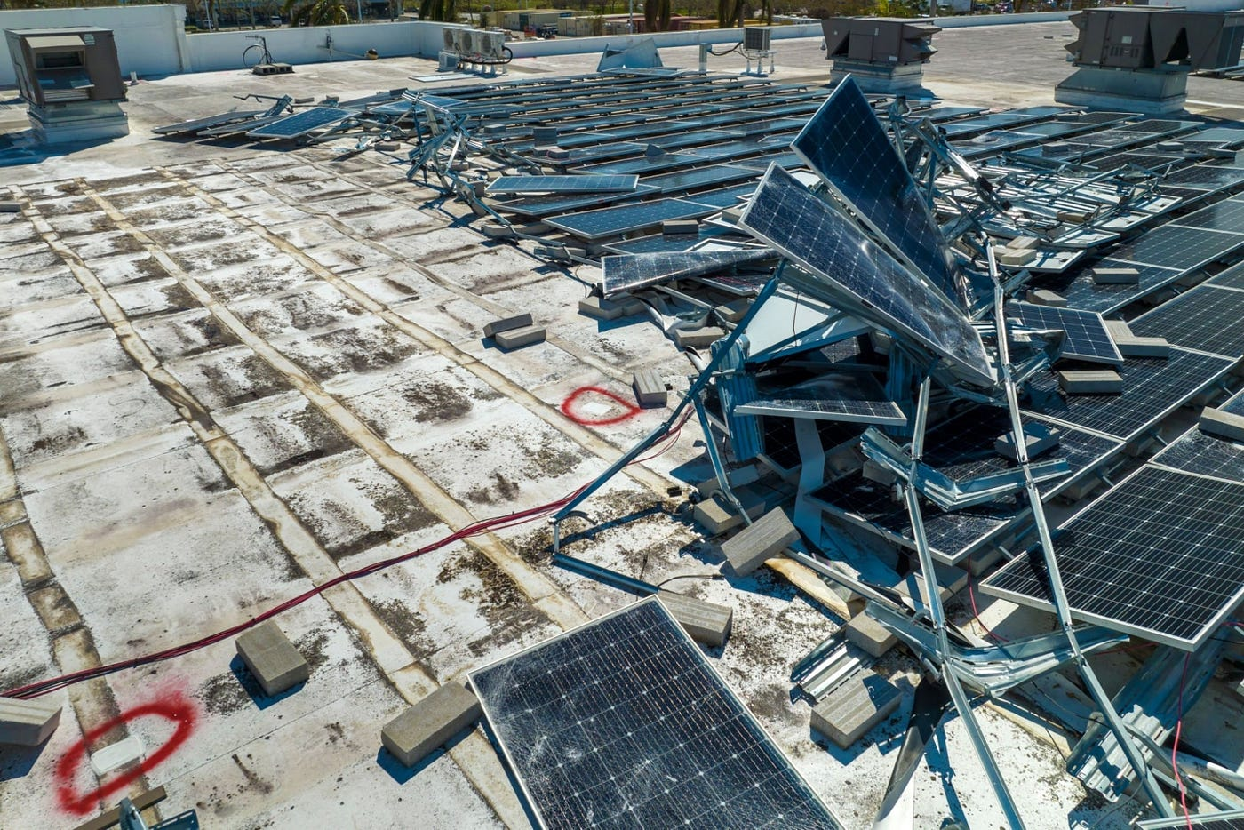
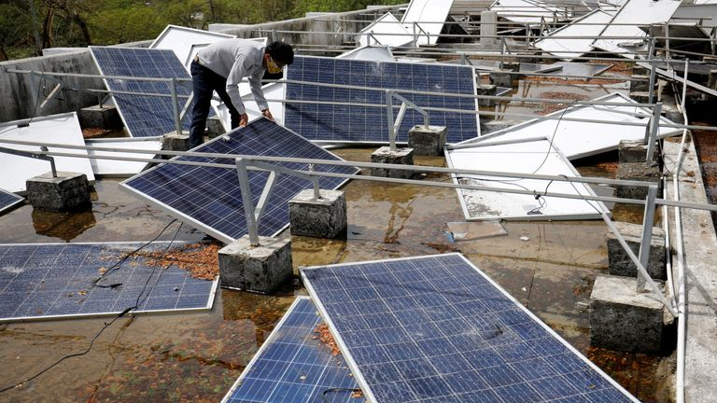
BACKGROUND & PROBLEM STATEMENT
Motivation & Failure Modes in Extreme Cyclonic Weather
Recent severe tropical cyclones in coastal India demonstrate systemic vulnerabilities in current mounting designs.
The Engineering & Regulatory Challenge
• Rapid Solar PV Scaling Across Vulnerable Coasts
India now operates over 90 GW of solar capacity, generating ~140 TWh annually. Large utility-scale plants are concentrated in coastal Gujarat, Rajasthan, and Odisha.
• Catastrophic Cyclone Damage Observations
Severe cyclones—Tauktae (2021, gusts ~220 km/h), Biparjoy (2023, ~165 km/h), and Fani (2019, ~215 km/h)—caused 15% to 20% physical damage across utility solar arrays.
• Regulatory Standard Omission (IS 875 Part 3)
Current Indian Standard IS 875 (Part 3) provides wind loads for standard buildings and solid walls, but lacks dedicated guidelines for low-profile tilted PV arrays, multi-row wake interferences, and gap ground effects.
• Critical Structural Failure Modes
Observed failures include module tearing, purlin bolt shearing, tracker torque-tube twisting under quartering winds, and extreme upward suction tearing panels from mounting clamps.
▲ Field evidence: Cyclone Tauktae (2021) and Cyclone Biparjoy (2023) ground & rooftop structural failures.

Slide 3
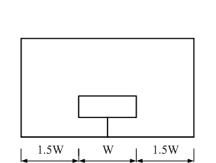
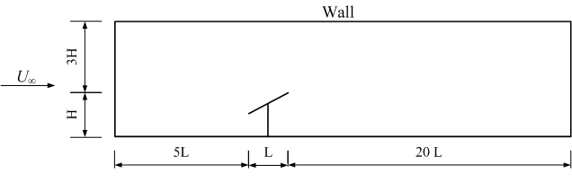
METHODOLOGY | COMPUTATIONAL SETUP
Geometric Configuration & Computational Domain Design
Domain dimensions, blockage ratio control, and local Volume of Refinement (VOR) sizing.
Domain Dimensions & Boundary Sizing
• Solar Panel Physical Dimensions
Length (chord) L = 0.600 m, Width W = 0.500 m, Thickness t = 0.020 m. Mounted at ground clearance height H = 0.500 m.
• Computational Domain Span (25L × 3W × 3H)
Total streamwise length = 25L (15.0 m total: 5L upstream fetch to avoid inlet backpressure, 20L downstream for full wake development). Width = 3W (1.8 m), Height = 3H (1.24 m).
• Blockage Ratio Minimization (< 3%)
Frontal projected area creates a blockage ratio < 3%, well below the 5% threshold recommended by COST 732 / Franke et al. guidelines to avoid artificial wall confinement.
• Volume of Refinement (VOR)
Near-field nested box: 8.5L total length (1.5L upstream, 7.0L wake), 2W width, 2.0 m height to capture shear layers and recirculation.
BOUNDARY CONDITIONS SUMMARY:
• Inlet: Uniform velocity (3 to 75 m/s), Turbulence Intensity I = 10%
• Outlet: Pressure outlet (p = 0 Pa gauge) | Ground & Panel: No-slip wall (U = 0)
• Sides & Top: Symmetry planes (zero normal gradients, zero wall friction)
▲ Spatial domain: Front view (lateral 1W clearances) and Side view (25L streamwise fetch). Inner boundary highlights Volume of Refinement (VOR) enclosing near-field recirculation.

Slide 4
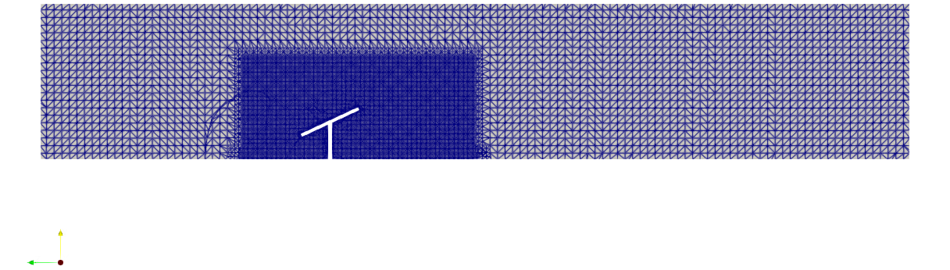
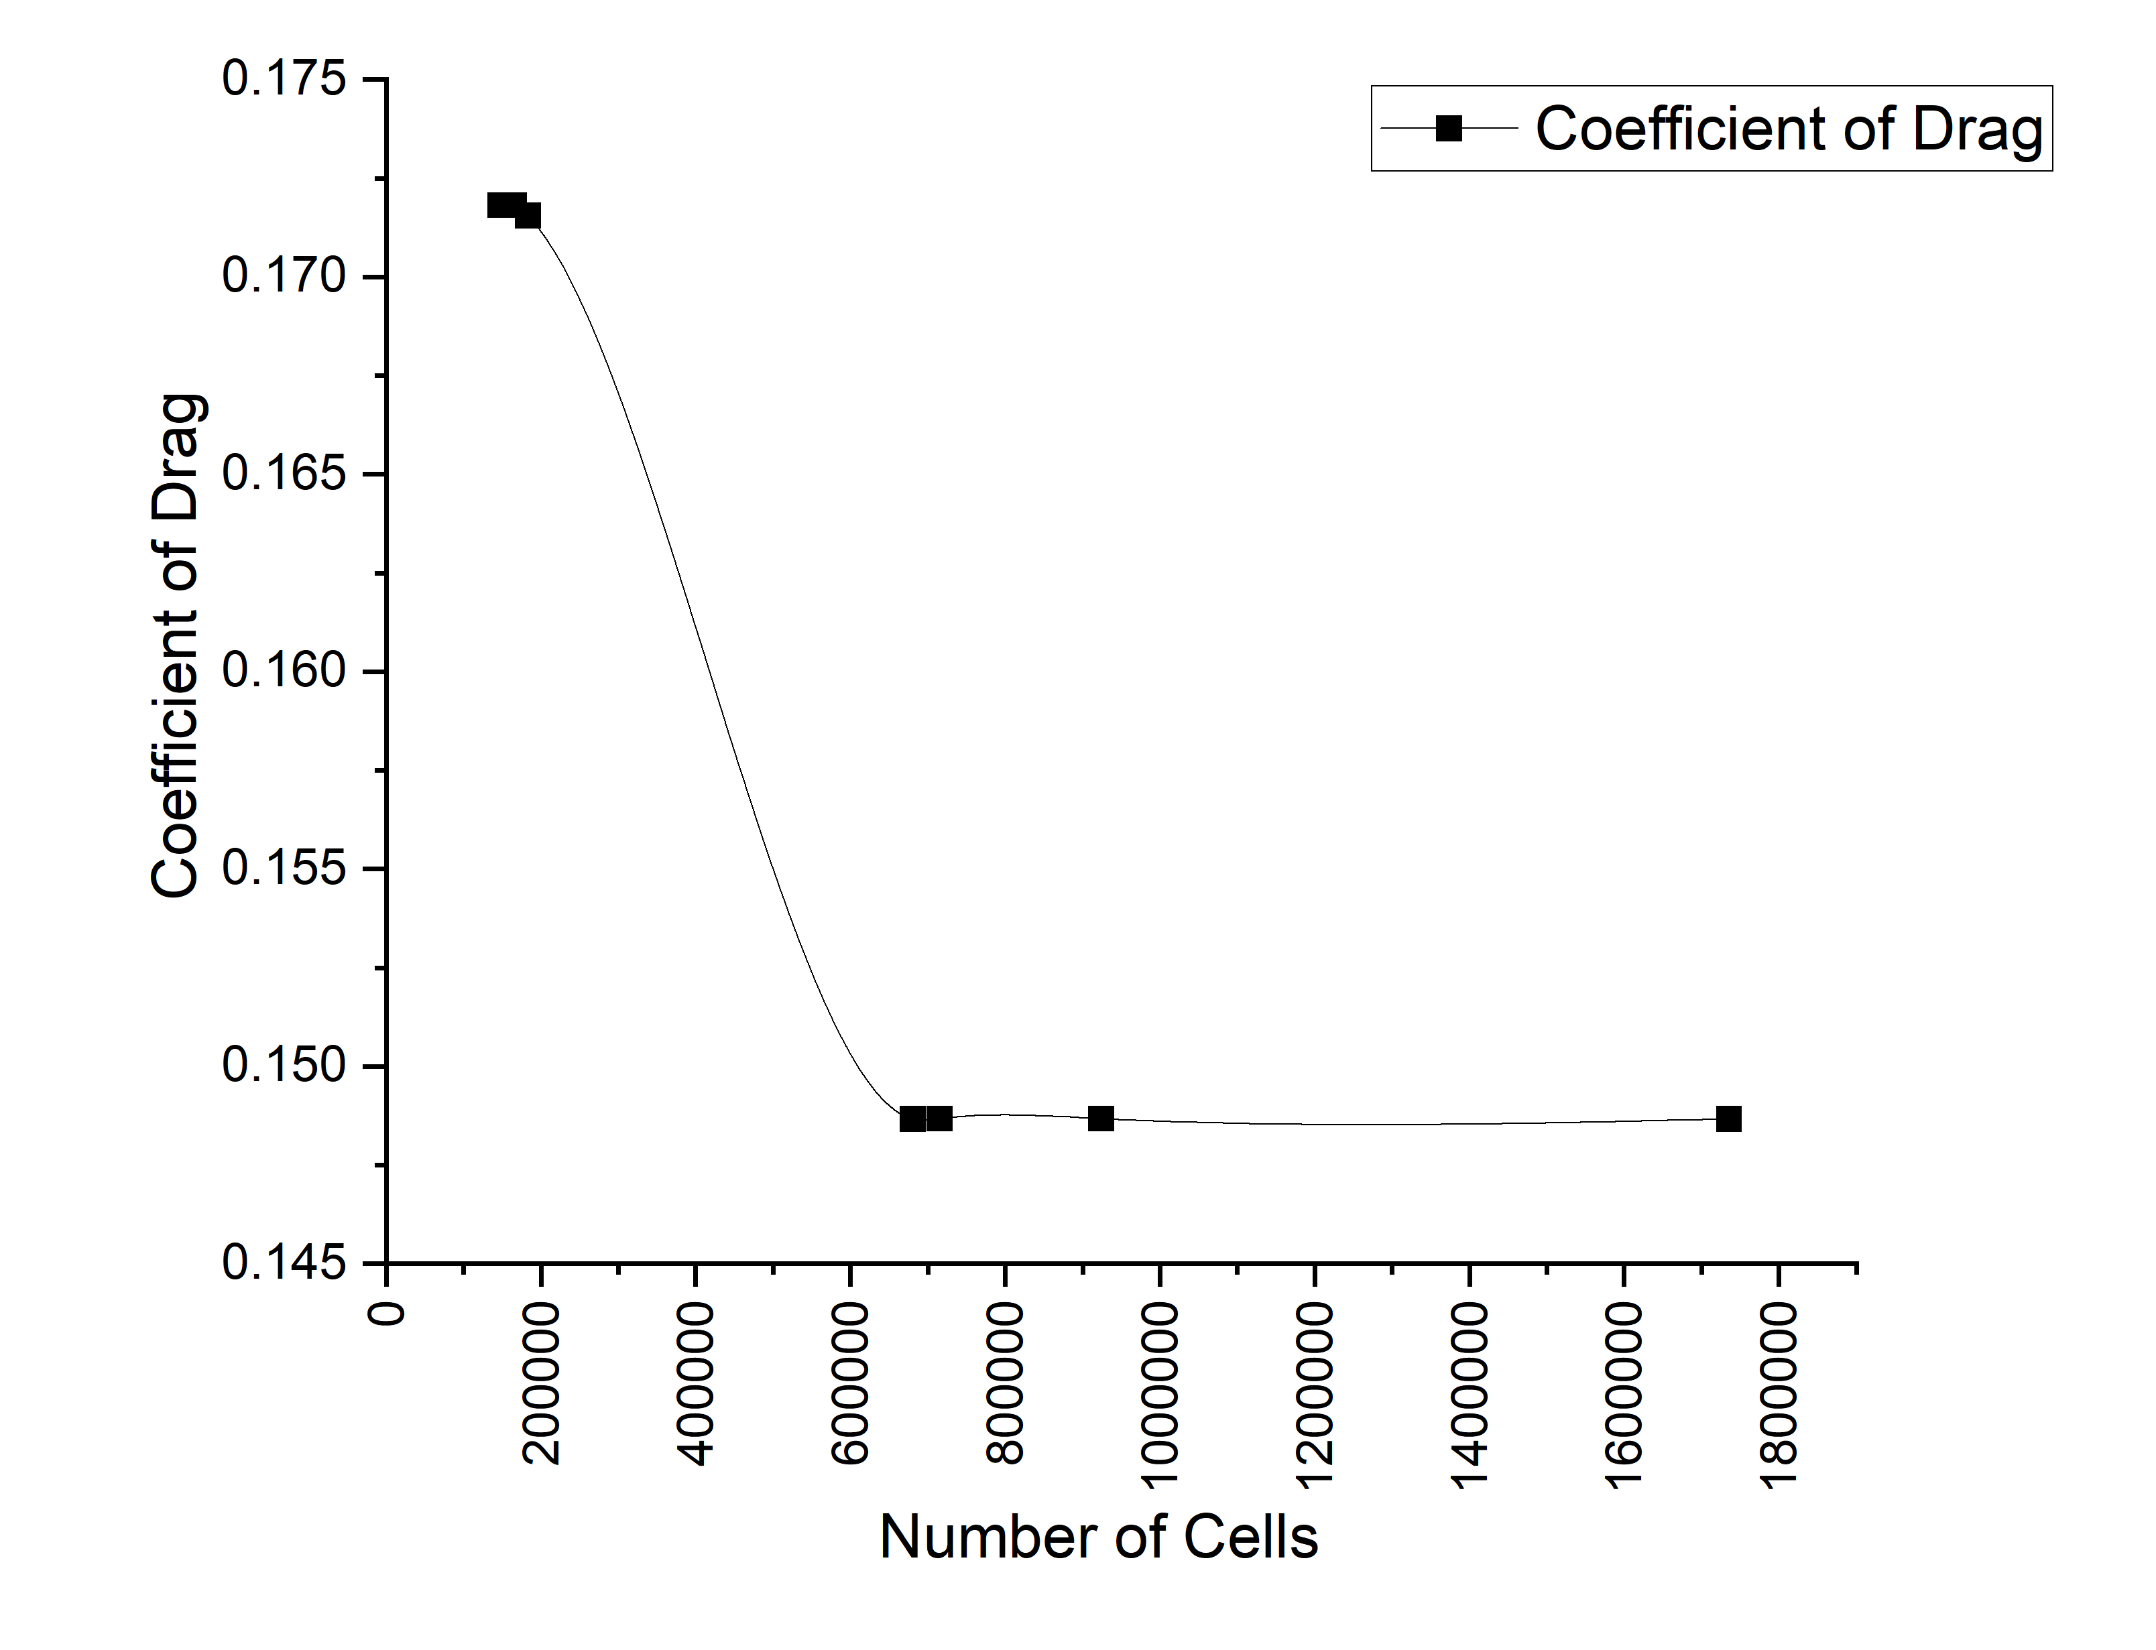
METHODOLOGY | MESH VERIFICATION
Mesh Generation & Rigorous Grid Independence Study
Mesh quality assessment and asymptotic drag convergence achieved at ~680k cells.
Level | Cell Count | Drag Fd (N) | Cd | Change (%) | Convergence Status
Mesh 1 | 147,253 | 13.238 | 0.1745 | — | Coarse Baseline
Mesh 2 | 165,341 | 13.038 | 0.1718 | 1.53% | Under-resolved
Mesh 3 | 183,429 | 13.018 | 0.1716 | 0.15% | Transitional Wake
Mesh 4 | 680,590 | 11.282 | 0.1487 | 15.39% | Shear Layer Resolved
Mesh 5 | 715,391 | 11.282 | 0.1487 | -0.003% | Asymptotic Plateau
Mesh 6 | 924,009 | 11.282 | 0.1487 | +0.001% | Production Standard
Mesh 7 | 1,735,557 | 11.282 | 0.1487 | +0.001% | Grid-Independent
MESH METRICS & CONVERGENCE FINDINGS:
• Mesher: OpenFOAM snappyHexMesh with 3 refinement levels and boundary layer snapping.
• Quality Check (912k Mesh): Max Aspect Ratio = 3.46, Max Non-Orthogonality = 36.07° (<70° limit), Max Skewness = 4.18.
• Key Finding: Drag coefficient stabilizes at Cd = 0.1487 beyond 680,590 elements. The 15.39% step change between 183k and 680k marks the capture of thin leading-edge separation.

Slide 5
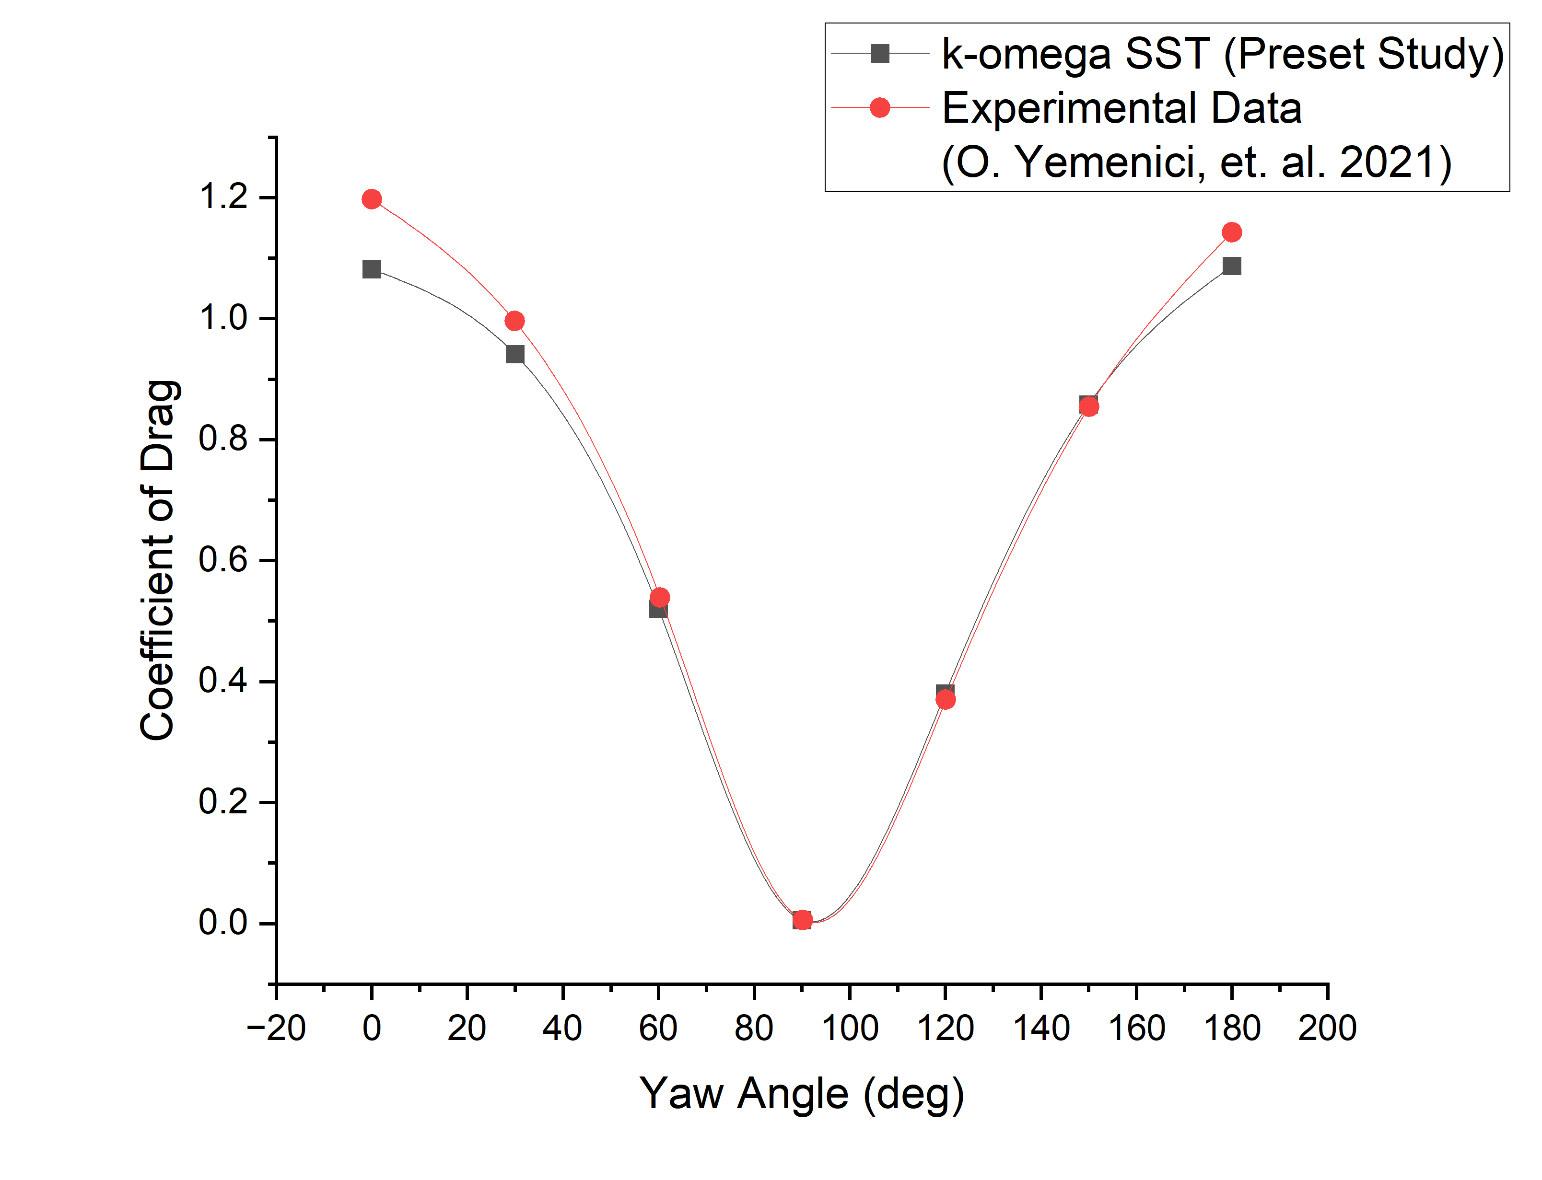
MODEL VERIFICATION | YEMENICI ET AL. (2021)
Experimental Validation Against Wind Tunnel Benchmark
High-fidelity correlation with published wind tunnel drag across 0° to 180° rotation angles.
Yaw Angle ψ | OpenFOAM Cd | Exp. Cd (Yemenici) | Deviation (%) | Flow Physics Regime
0° | 1.0813 | 1.1973 | 9.68% | Direct frontal stagnation
30° | 0.9412 | 0.9959 | 5.50% | Oblique boundary layer detachment
60° | 0.5203 | 0.5388 | 3.43% | Strong lateral streamline deflection
90° | 0.0055 | 0.0054 | 0.32% | Edge-on minimum frontal area
120° | 0.3800 | 0.3701 | 2.69% | Onset of leeward recirculation
150° | 0.8581 | 0.8544 | 0.43% | Rear oblique vortex expansion
180° | 1.0867 | 1.1429 | 4.91% | Full leeward bluff stagnation
VALIDATION ASSESSMENT & FIDELITY:
• Mean Absolute Error: 3.85% across all 7 rotation angles, confirming excellent predictive accuracy.
• Peak Agreement: Near-perfect capture of minimum drag at 90° (0.32% error) and rear stagnation at 150° (0.43% error).
• Minor Differences: Underprediction at 0° (~9.7%) is attributable to experimental bracket mount interference and tunnel boundary layers omitted from the isolated CFD model.
3.85% Mean Error
OpenFOAM k-ω SST vs Experimental Benchmark

Slide 6
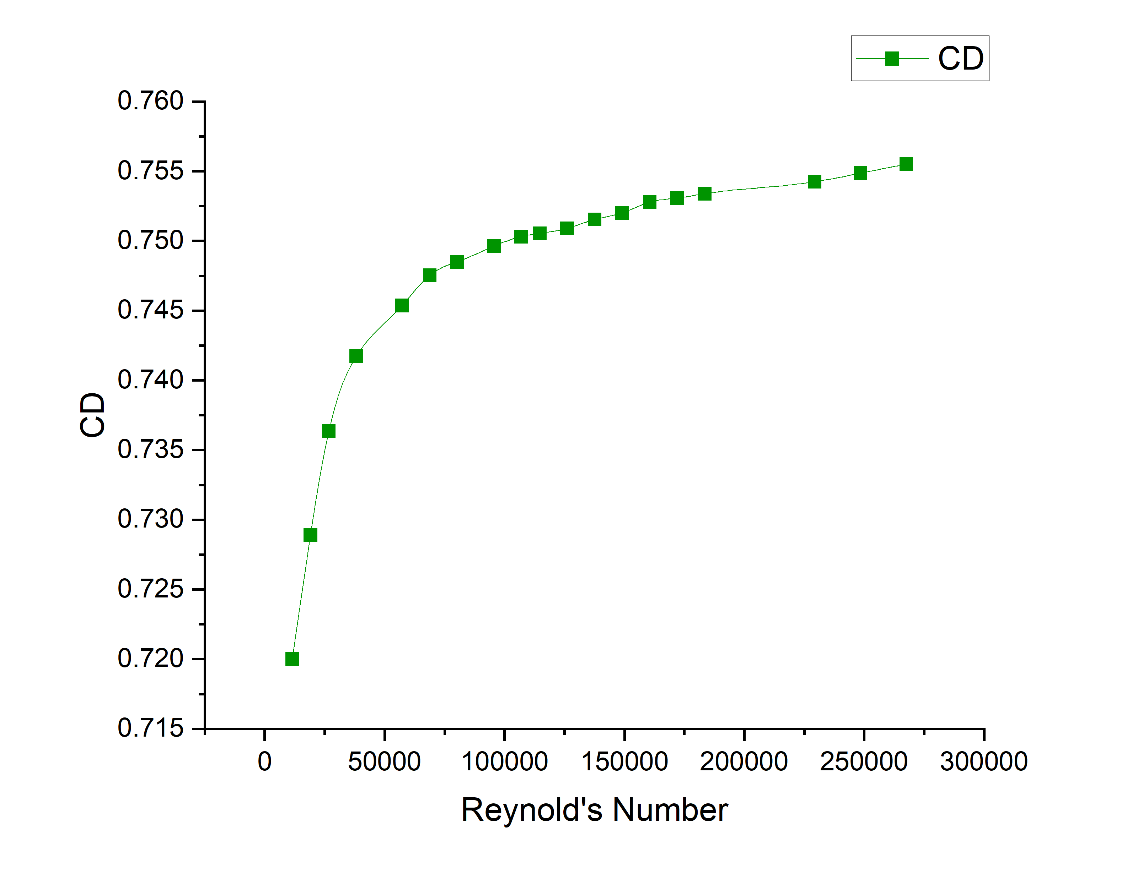
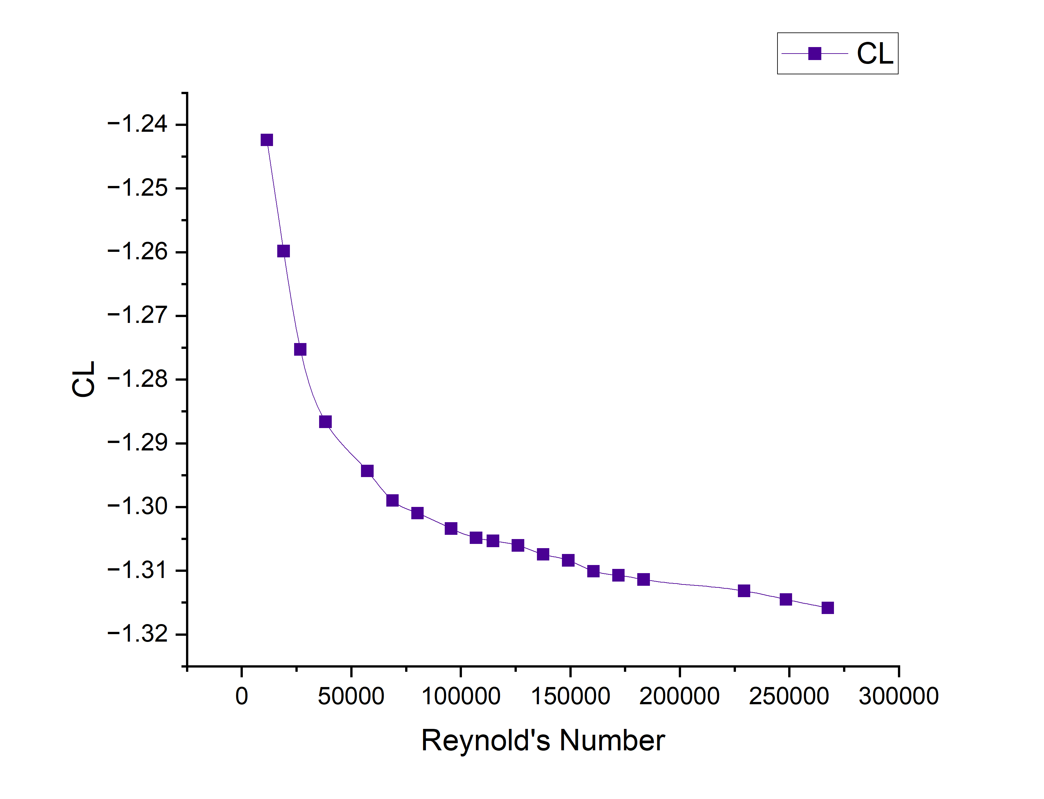
AERODYNAMIC CHARACTERISTICS | RE SCALING
Wind Velocity Scaling & Reynolds Number Independence
Forces scale with velocity squared (U²) while aerodynamic drag coefficient plateaus at Re > 50,000.
Reynolds Number Effects & Dynamic Force Scaling
• Broad Range Investigated (3 to 75 m/s)
Velocity sweep covers Re = 11,465 (gentle breeze, 3 m/s) to Re = 286,624 (Category 5 hurricane gust, 75 m/s) with characteristic length D = 0.6 m.
• Bluff-Body Re Independence
Drag coefficient Cd increases from 0.70 at 3 m/s and plateaus at ~0.78-0.80 beyond Re > 50,000 (15 m/s). Because separation is fixed by sharp plate edges, Cd becomes Reynolds-independent in stormy winds.
• Negative Lift (Downward Suction) Dominance
At 0° yaw, lift coefficient CL remains consistently negative (CL ≈ -1.22), imposing strong downward crushing loads onto purlins and foundations.
• Quadratic Dynamic Force Surge (F ∝ U²)
At 3 m/s: Drag = 0.55 N, Lift = -1.07 N.
At 15 m/s: Drag = 13.02 N, Lift = -25.8 N.
At 75 m/s (Cyclone Gust): Drag surges to ~340 N and downward force exceeds 650 N on a single compact 0.3 m² panel!
F ∝ U² Quadratic Scaling
Forces amplify 600x from 3 m/s to 75 m/s gust while Cd remains invariant (~0.78)

Slide 7
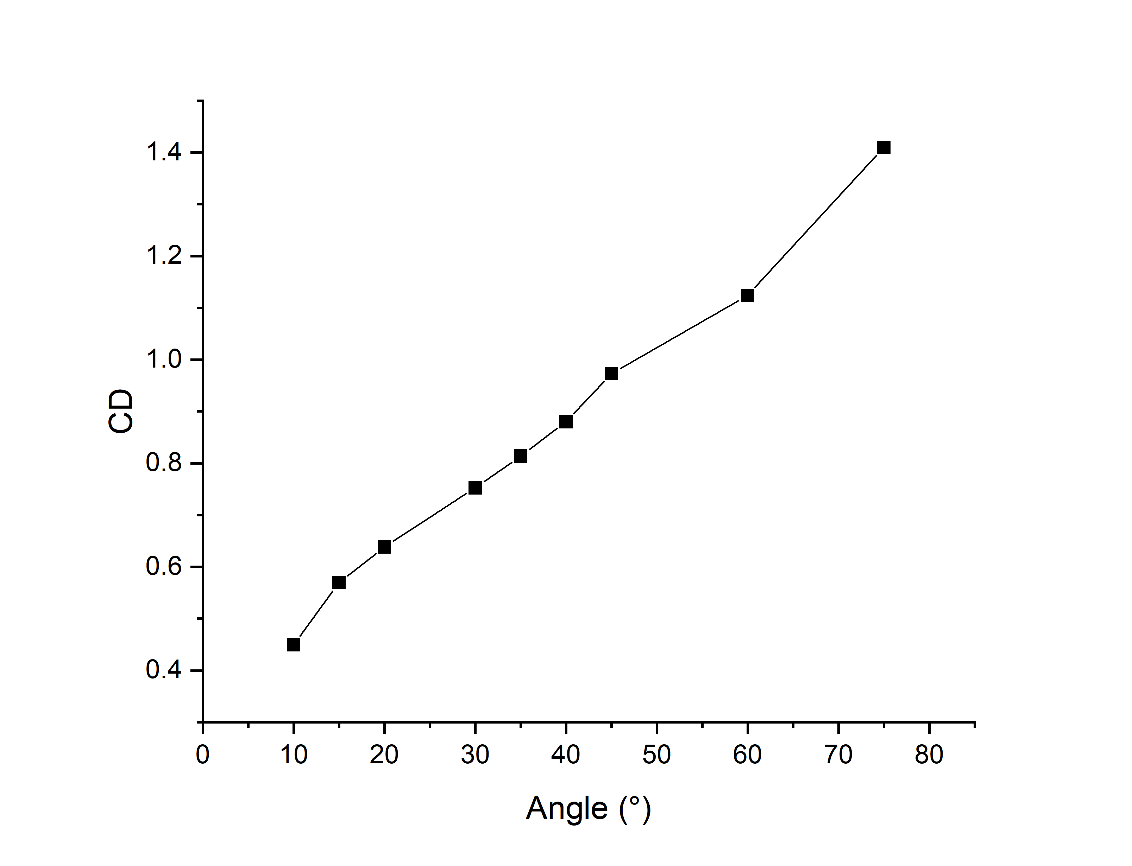
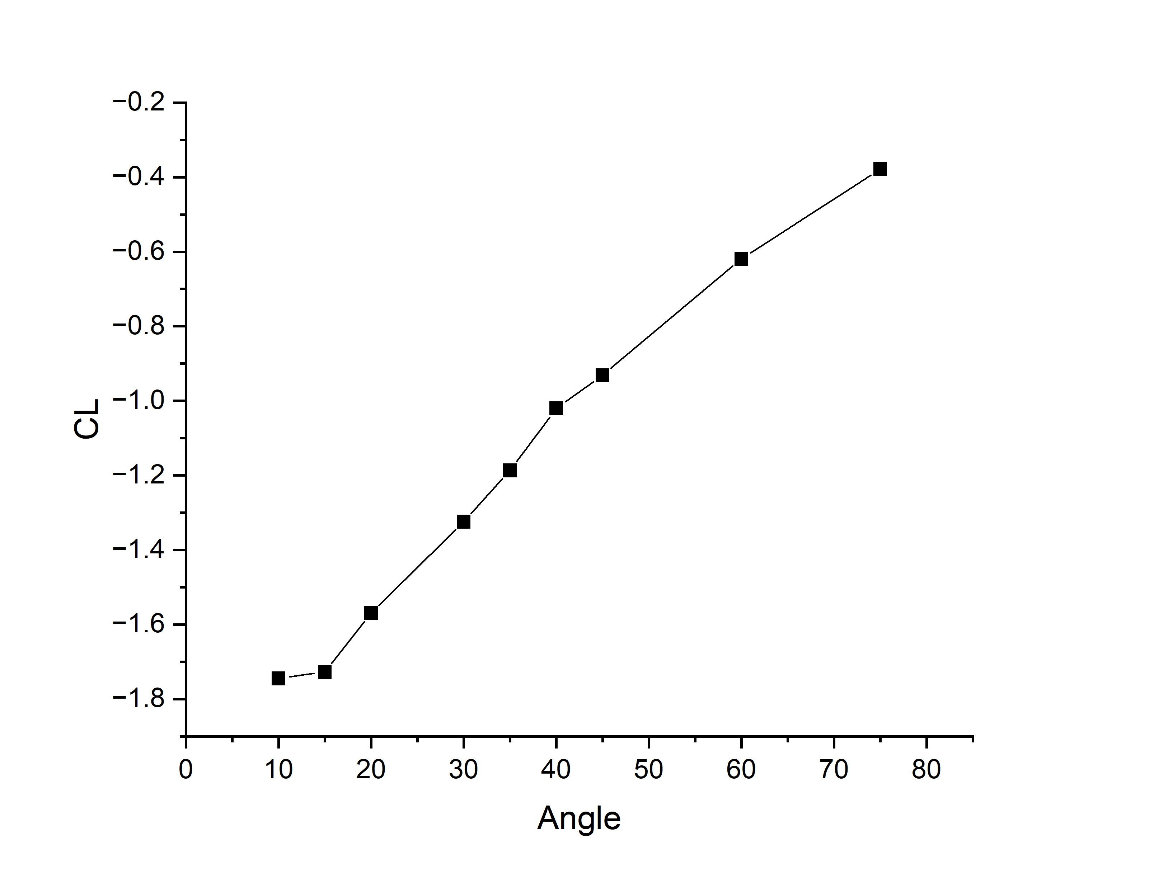
PARAMETRIC STUDY | PANEL TILT
Panel Tilt Angle Sweep (10° to 75°): Solar Yield vs. Drag Trade-off
Drag increases monotonically by 313% from 10° to 75°; 30° represents the optimal balance with annual solar irradiation.
Tilt Angle θ | Proj. Area (m²) | Cd | CL | Structural Design Impact
10° | 0.0688 | 0.4495 | -1.7446 | Minimum drag; peak downward suction
15° | 0.0938 | 0.5696 | -1.7273 | Low aerodynamic resistance
20° | 0.1180 | 0.6382 | -1.5693 | Common tropical installation angle
30° | 0.1637 | 0.7523 | -1.3241 | Optimal trade-off: Solar yield vs Wind load
35° | 0.1849 | 0.8137 | -1.1867 | Drag increases sharply (+81% vs 10°)
45° | 0.2229 | 0.9730 | -0.9313 | Overturning moment increases rapidly
60° | 0.2674 | 1.1237 | -0.6195 | Severe cyclonic detachment risk
75° | 0.2940 | 1.4097 | -0.3786 | Maximum overturning force (3.13x baseline)
CRITICAL FACTUAL CLARIFICATION:
• Drag is NOT minimized at 30°—it is lowest at 10° (Cd = 0.450) and increases continuously with tilt.
• 30° is an engineering optimum: Maximizes annual solar irradiance capture in Indian latitudes (15°-25°N) while preventing excessive aerodynamic drag penalties.
• Suction reversal: Downward suction (|CL| = 1.745) is highest at 10° due to Venturi upper-surface acceleration.
+313% Drag Surge
From 10° (Cd = 0.45) to 75° (Cd = 1.41) tilt angle

Slide 8
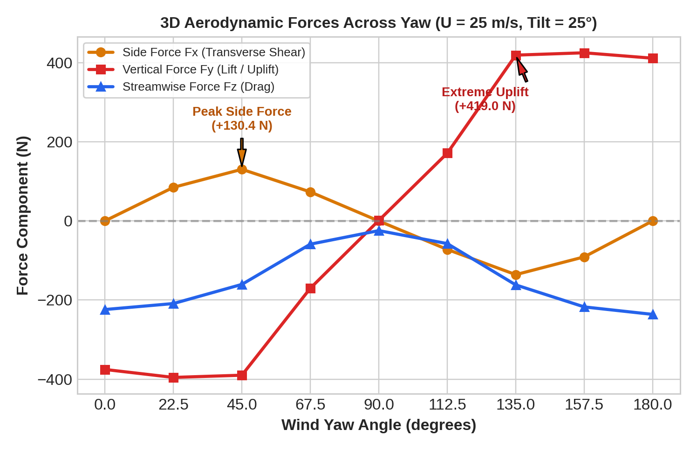
PARAMETRIC STUDY | YAW & MOMENTS
Wind Yaw Angle (0° to 180°): 3D Force Decomposition & Torsional Torque
Quartering wind (45°) induces peak lateral shear, while rear wind (135°-180°) triggers catastrophic uplift load reversal.
Yaw ψ | Flow Alignment | Side Fx (N) | Lift Fy (N) | Drag Fz (N) | Primary Structural Failure Threat
0° | Frontal Direct | 0.0 | -375.5 | -224.0 | Downstream compression on foundation
22.5° | Slight Oblique | +84.8 | -395.6 | -208.9 | Combined compression and lateral shear
45° | Quartering Wind | +130.4 | -390.0 | -160.5 | PEAK lateral shear & tracker torque twist
67.5° | High Oblique | +73.2 | -170.1 | -58.8 | Moderate asymmetric loading
90° | Parallel / Edge-on | -0.3 | +1.2 | -24.5 | Minimal forces (glancing flow)
112.5° | Rear Oblique | -72.2 | +171.2 | -57.4 | Lift flips to positive (onset of uplift)
135° | Quartering Leeward | -135.8 | +419.0 | -161.8 | PEAK uplift pull-out + severe yaw torque
157.5° | Severe Leeward | -90.9 | +424.9 | -217.4 | Extreme upward tensile load on purlins
180° | Rear Direct | 0.0 | +411.2 | -236.3 | Extreme uplift ripping modules off clamps
TWO CRITICAL CYCLONIC THREATS DISCOVERED:
1. Load Reversal (+786 N Net Delta): Wind shifting from 0° (-375 N compression) to 180° (+411 N uplift) pulls panels upward—the primary cause of module fly-offs during cyclone passage.
2. Quartering Torsional Twist: Lateral force spikes to |Fx| > 130 N at 45°/135°, creating severe twisting moments on torque tubes.

Slide 9
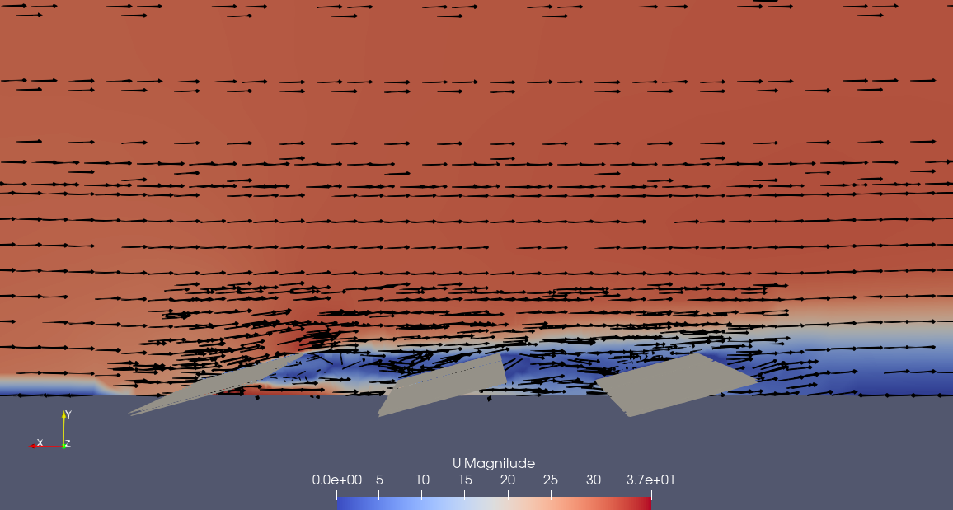
ARRAY AERODYNAMICS | SHELTERING EFFECT
Sheltering Effect in Multi-Row Solar Arrays (Normal Wind)
Upstream panels deflect incoming flow, reducing aerodynamic drag on downstream rows by 61% to 79%.
Array Position | Cd (55 m/s) | CL (55 m/s) | Drag Reduction (%) | Lift Reduction (%)
Row 1 (Leading Edge) | 0.4598 | -1.1691 | Baseline (0%) | Baseline (0%)
Row 2 (Intermediate) | 0.1772 | -0.4807 | 61.5% Lower Drag | 58.9% Lower Suction
Row 3 (Trailing Row) | 0.0967 | -0.2818 | 79.0% Lower Drag | 75.9% Lower Suction
Aerodynamic Mechanisms Driving Array Sheltering
• Leading Row Boundary Layer Deflection
The first row acts as an aerodynamic bluff barrier, forcing approaching streamlines upward and triggering leading-edge flow separation.
• Velocity Deficit in the Array Wake
Downstream rows operate inside the wake recirculation zone where mean streamwise velocity is reduced by 40-55%, slashing dynamic pressure (q = 1/2 ρ U²).
• Turbulence Dissipation & Reattachment
Intermediate rows experience steady wake shedding. Pitch spacing (2.5L) ensures the shear layer reattaches downstream of Row 3, protecting inner rows.
• Array Structural Optimization
Structural members in inner rows can be lightened by ~50%, while outer perimeter mounts must bear 100% design gust pressure.
79% Drag Reduction
Trailing row experiences under one-fourth the drag of the leading row under frontal wind

Slide 10
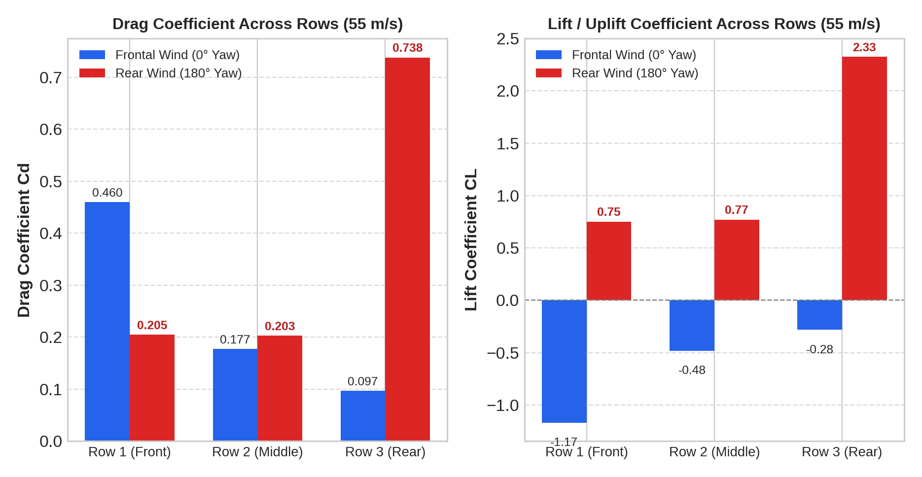
ARRAY AERODYNAMICS | CYCLONE DIRECTIONAL SHIFT
The Inverted Sheltering Hazard: Rear & Oblique Wind Shifts
When cyclonic winds shift to the rear (180°), sheltering is destroyed: trailing rows face +260% drag and catastrophic uplift.
Array Row | Frontal (0°) Cd | Frontal (0°) CL | Rear (180°) Cd | Rear (180°) CL | Wind Direction Delta
Row 1 (Front) | 0.4598 | -1.169 | 0.2049 | +0.752 | Sheltered from rear; uplift flip
Row 2 (Middle) | 0.1772 | -0.481 | 0.2027 | +0.771 | Slight load increase; uplift flip
Row 3 (Rear) | 0.0967 | -0.282 | 0.7384 | +2.327 | +260% Drag Surge & Extreme Uplift!
WHY ARRAYS FAIL DURING CYCLONE EYE PASSAGE:
• The 'Safe Row' Illusion: Engineers often assume trailing rows (Row 3) are protected by sheltering and use lighter brackets. When the cyclone eye passes and winds reverse (180°), Row 3 becomes the primary windward obstacle.
• Extreme Rear Uplift (CL = +2.327): The inclined rear surface creates an aggressive aerodynamic ramp that generates +2.327 uplift coefficient—over double the magnitude of frontal wind!
• Fatal Flaw in Single-Direction Racking: Arrays must be engineered with symmetric structural load capacities on both northern and southern boundaries.

Slide 11
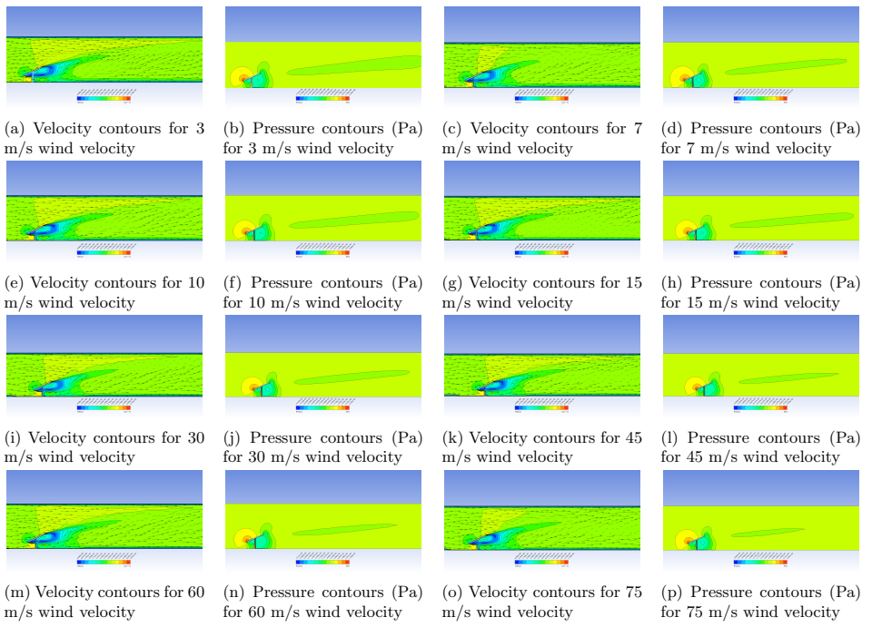
AERODYNAMIC PHYSICS | FLOW FIELD
Flow Physics: Surface Pressure & Velocity Contours (3 to 75 m/s)
Detailed examination of leading-edge suction peaks, stagnation zones, and recirculating wake dynamics.
Key Fluid Dynamics Mechanisms
• Leading-Edge Suction Peak (Bernoulli)
Air accelerates rapidly over the upper front edge, dropping local static pressure to extreme negative values (suction ΔCp < -2.5). This localized suction causes edge panel debonding.
• Windward Stagnation Bubble
A high-pressure positive zone develops on the lower front inclined surface, converting incoming dynamic head (1/2 ρ U²) directly into structural compression.
• Adverse Pressure Gradient & Separation
Downstream of the leading edge, sharp adverse pressure gradients force the boundary layer to detach, forming a large recirculating separation bubble.
• Dynamic Pressure Scaling Across Speeds
While streamline geometry remains invariant due to bluff-body separation, local suction scales quadratically: -14 Pa at 3 m/s surging to -8,800 Pa at 75 m/s!
▲ Velocity & Pressure magnitude contours across 3, 7, 10, 15, 30, 45, 60, and 75 m/s wind velocities.

Slide 12
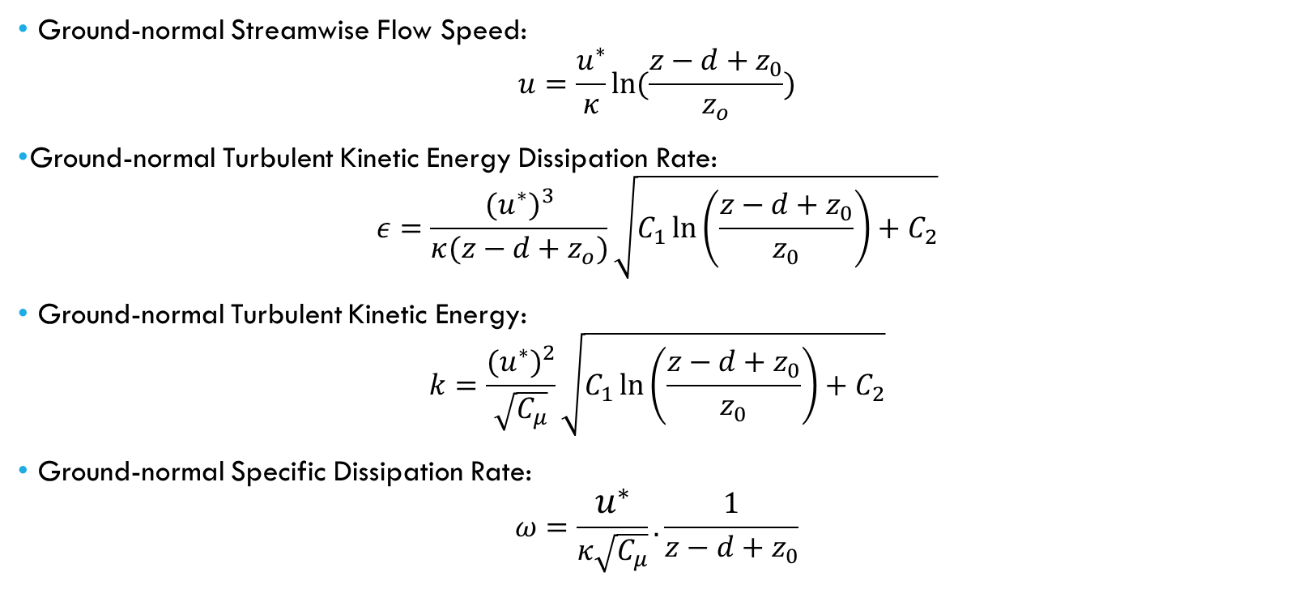
THEORETICAL METHODOLOGY | BOUNDARY LAYER FORMULATION
Inflow Modeling: Atmospheric Boundary Layer (ABL) vs. Uniform Flow
Equations governing wind shear and turbulence closure for real-world ground and rooftop installations.
Why Uniform Flow vs. Real-World ABL?
• Wind Tunnel Benchmark Validation
Uniform flow was applied to replicate standard wind tunnel testing conditions (Yemenici et al., 2021) and validate isolated aerodynamic drag coefficients.
• Terrain Surface Roughness Effects
In actual solar farms, ground roughness retards near-surface flow. ABL wind profiles produce vertical velocity shear, creating lower wind speeds at the bottom chord and higher speeds at the top.
• Turbulent Buffeting & Dynamic Gusts
Ground-generated turbulence induces dynamic pressure fluctuations. While steady RANS with uniform flow provides baseline design limits, ABL profiles are necessary for aeroelastic fatigue life prediction.
• OpenFOAM Implementation Path
Future field models will employ OpenFOAM's atmBoundaryLayerInletVelocity and atmBoundaryLayerInletK boundary conditions with calibrated terrain categories.
ABL MATHEMATICAL FORMULATION:
• u(z) = (u*/κ) ln((z - d + z₀)/z₀): Logarithmic velocity shear profile.
• k(z) & ω(z): Turbulent kinetic energy and specific dissipation for k-ω SST.
• Key Parameters: Friction velocity u*, von Kármán constant κ = 0.41, aerodynamic roughness length z₀ (0.03 m for open terrain), displacement height d.

Slide 13
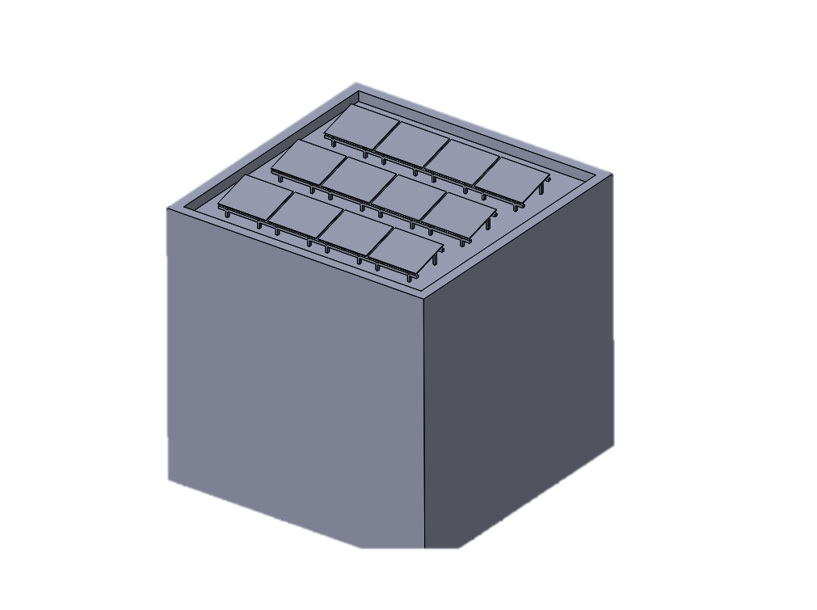
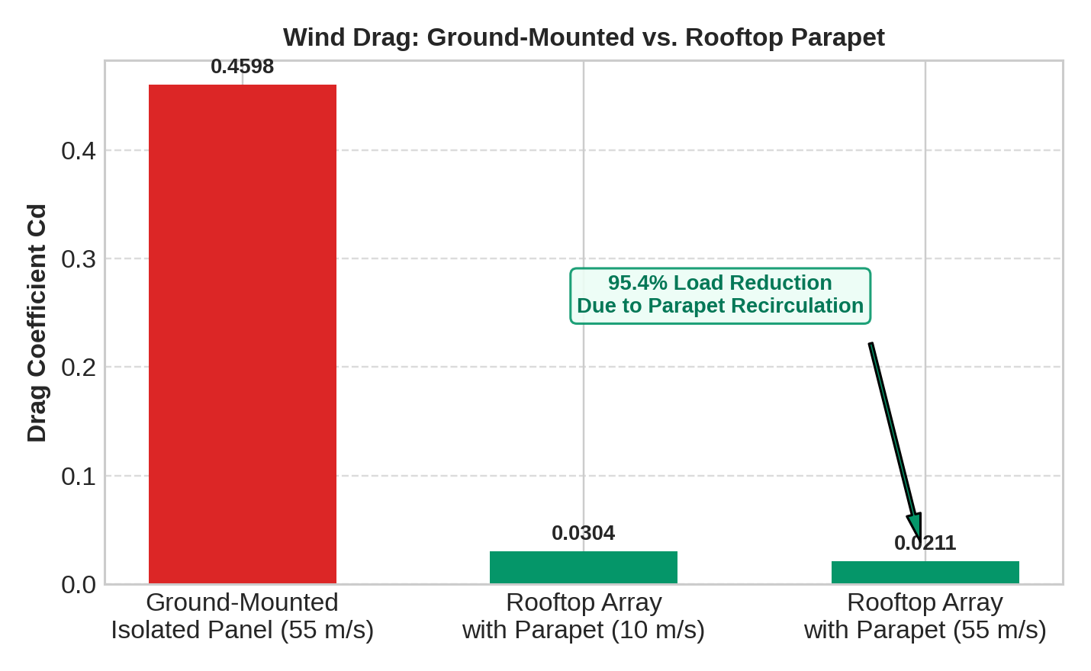
ROOFTOP APPLICATIONS | BUILDING INTEGRATION
Rooftop PV Aerodynamics: Over 95% Drag Reduction with Parapets
Perimeter parapet walls deflect incoming airflow, enclosing rooftop panels in a low-velocity recirculating dead-zone.
Configuration | Wind Speed | Drag Cd | Lift CL | Aerodynamic Drag Reduction
Ground-Mounted Panel | 55 m/s | 0.4598 | -1.1691 | Baseline (100% Load)
Rooftop Array with Parapet | 10 m/s | 0.0304 | +0.0750 | 93.4% Lower Drag
Rooftop Array with Parapet | 55 m/s | 0.0211 | +0.0560 | 95.4% Lower Drag!
Aerodynamic Mechanisms on Rooftops
• Building Facade Streamline Updraft
As wind strikes the vertical building facade, it is forced sharply upward, shooting over the roof edge and overshooting the solar panels.
• Parapet Recirculation Dead-Zone
The 0.5-1.0 m parapet wall prevents the boundary layer from dipping onto the roof deck, creating a massive recirculation bubble containing low-momentum air.
• Near-Zero Uplift Risk
Unlike ground-mounted panels which suffer massive uplift (CL > +2.0 under rear winds), rooftop panels remain neutrally buoyant (CL ≈ +0.056).
• Architectural Recommendation
Mandating a 0.75 m perimeter parapet on commercial roofs virtually eliminates the need for heavy ballast blocks or structural roof penetrations.
95.4% Drag Reduction
Rooftop parapet wall eliminates over nineteen-twentieths of storm wind drag at 55 m/s

Slide 14
CONCLUSIONS & RECOMMENDATIONS
Engineering Design Guidelines & Future Research Roadmap
Actionable structural strategies for cyclone resilience and upcoming computational milestones.
Actionable Industry Guidelines for Cyclone Resilience
• Dynamic Cyclone Stowing (0° to 10° Tilt)
Trackers must automatically stow at shallow angles (0°-10°) upon storm warning, reducing aerodynamic drag by 68% compared to steep tilts (45°-75°).
• Dual-Perimeter Clamp Reinforcement (+420 N Uplift)
Fasteners must be rated for +420 N tensile pull-out to withstand rear-wind uplift (180° yaw). Both northern and southern boundary rows require reinforced purlins.
• Quartering Torsional Damping (45° / 135°)
Tracker torque tubes require increased torsional rigidity and mechanical dampers to withstand high lateral shear (|Fx| > 130 N) and eccentric twisting moments.
• Parapet Integration on Commercial Roofs
Building codes (IS 875) should require 0.75 m parapet walls for rooftop solar installations to leverage 95% aerodynamic load shielding.
Future Research Roadmap & Computational Scope
• Unsteady Large Eddy Simulation (LES / DDES)
Advance beyond steady RANS to capture transient vortex shedding and unsteady buffet frequencies (cases prepared in PT25_Y0_Unsteady/ with pimpleFoam).
• Atmospheric Boundary Layer (ABL) Wind Shear
Integrate logarithmic velocity and turbulence profiles into multi-row farm simulations to capture ground-shear interaction.
• Full Fluid-Structure Interaction (FSI)
Couple OpenFOAM pressure fields with structural FEA to evaluate dynamic flutter, aeroelastic twisting, and fatigue life under cyclonic gusts.
• Field Calibration & Sensor Validation
Deploy wireless surface pressure taps and load cells on operational coastal utility arrays to correlate CFD predictions with live hurricane data.

